Slide 1


GitOps in AKS with Flux
Infrastructure as Code User Group Oslo
03.11.2021
with Evgeny Borzenin

Slide 2

Infrastructure as Code User Group 2021 roadmap
AKS workshops roadmap:
[x] AKS and Kubernetes 101
[x] Advanced AKS configuration
[x] Implement Immutable AKS Infrastructure on Azure with Bicep
[ ] GitOps in AKS with Flux
[ ] Service mesh with linkerd
[ ] Monitoring in AKS
[ ] AKS security
+ “regular” events (work in progress)
If you have any good AKS / Kubernetes / IaC story – welcome to share!

Slide 3
Practical information
Mix of slides and labs with focus on labs
I don’t have moderator
Let’s help each other, the one who finished earlier can help others
Keep the same names as in labs -> easier to troubleshot
Share your screen if you stack with some issues
Labs are available after the event

Slide 4
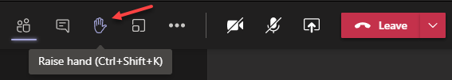
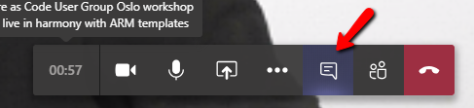

Microsoft Teams 101
Mute your mic (but don’t forget to unmute when you speak)
Feel free to use video
«Rise your hand» if you need some attention
Conversation/chat
Share screen

Slide 5
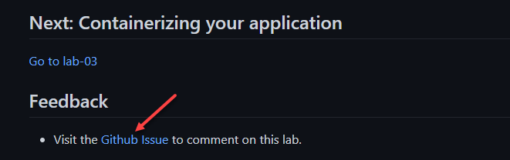
Practical information
Each lab is time-boxed (ish…)
When you done with lab, post to the Conversation channel
lab-01 (lab-02, lab-03 etc…)
Feel free to contribute to the labs content by fixing gramma, typos, wrong commands etc..
Feel free to comment on each lab

Slide 6
GitOps with Flux

Slide 7
Typical k8s configuration and maintenance
Provision AKS
Prepare manifest and helm. Possible with “master scripts”
Run master script and kubectl apply –f configuration to the cluster
Change k8s configuration:
Change configuration -> push to git -> kubectl apply –f from local PC
Issues – human factor:
Configuration drift
Risk of deploying things to the wrong cluster
Risk of deploying wrong recourses
Risk of forgetting to commit changes to the repository

Slide 8
GitOps principles
GitOps is a set of practices to manage infrastructure and application configurations using Git
Declarative description of system
Git as the single source of truth for all environments
Automatically apply approved changes
All changes via PR -> are observable/verifiable

Slide 9
flux overview
Flux is a set of continuous and progressive delivery solutions for Kubernetes that are open and extensible
Flux provides GitOps for both apps and infrastructure
Just push to Git and Flux does the rest
Flux works with your existing tools
Flux alerts and notifies
Users trust Flux

Slide 10
Who is Flux for?
cluster operators
platform engineers
app developers

Slide 11
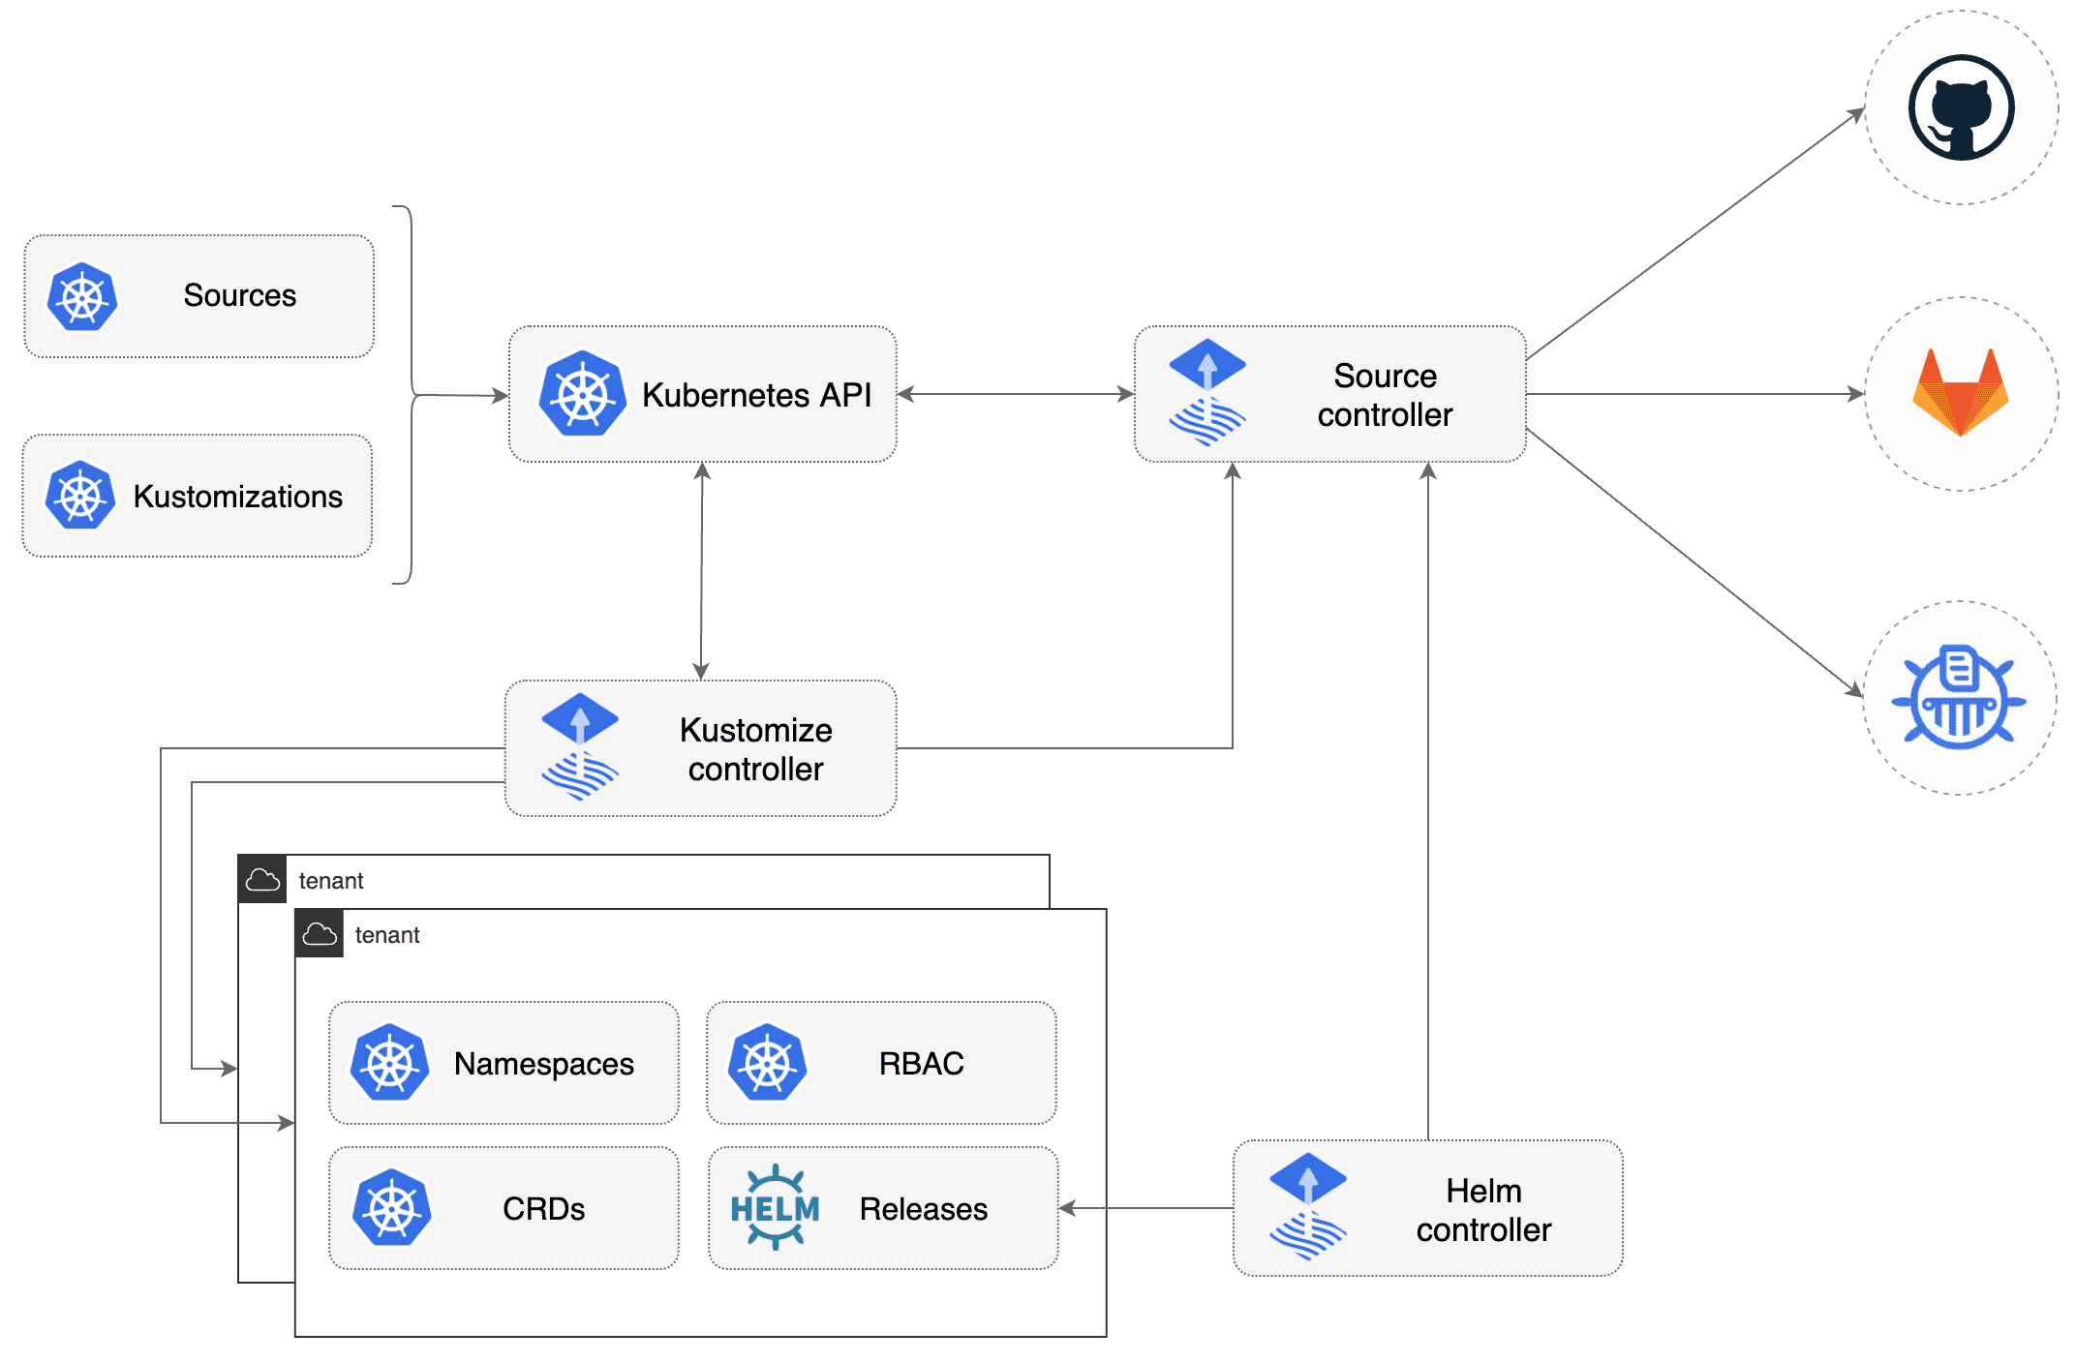
Flux components
Notes:
Flux is based on a set of Kubernetes API extensions (“custom resources”), which control how git repositories and other sources of configuration are applied into the cluster (“synced”). For example, you create a GitRepository object to mirror configuration from a Git repository, then a Kustomization object to sync that configuration.
Flux works with Kubernetes' role-based access control (RBAC), so you can lock down what any particular sync can change. It can send notifications to Slack and other like systems when configuration is synced and ready, and receive webhooks to tell it when to sync.
The flux command-line tool is a convenient way to bootstrap the system in a cluster, and to access the custom resources that make up the API.

Slide 12
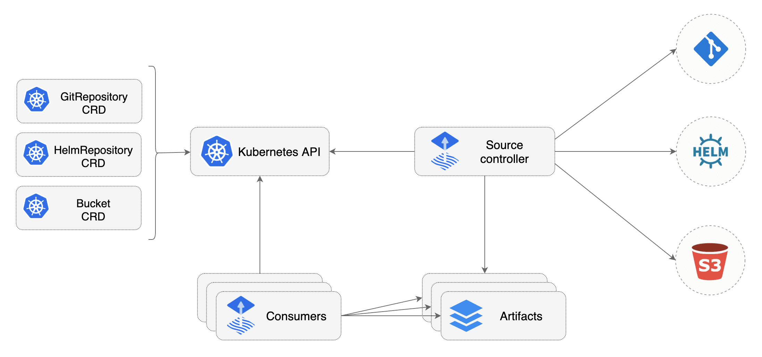
Source Controller
Notes:
The main role of the source management component is to provide a common interface for artifacts acquisition. The source API defines a set of Kubernetes objects that cluster admins and various automated operators can interact with to offload the Git and Helm repositories operations to a dedicated controller.
Validate source definitions
Authenticate to sources (SSH, user/password, API token)
Detect source changes based on update policies (semver)
Fetch resources on-demand and on-a-schedule
Package the fetched resources into a well-known format (tar.gz, yaml)
Make the artifacts addressable by their source identifier (sha, version, ts)
Make the artifacts available in-cluster to interested 3rd parties
Notify interested 3rd parties of source changes and availability (status conditions, events, hooks)

Slide 13
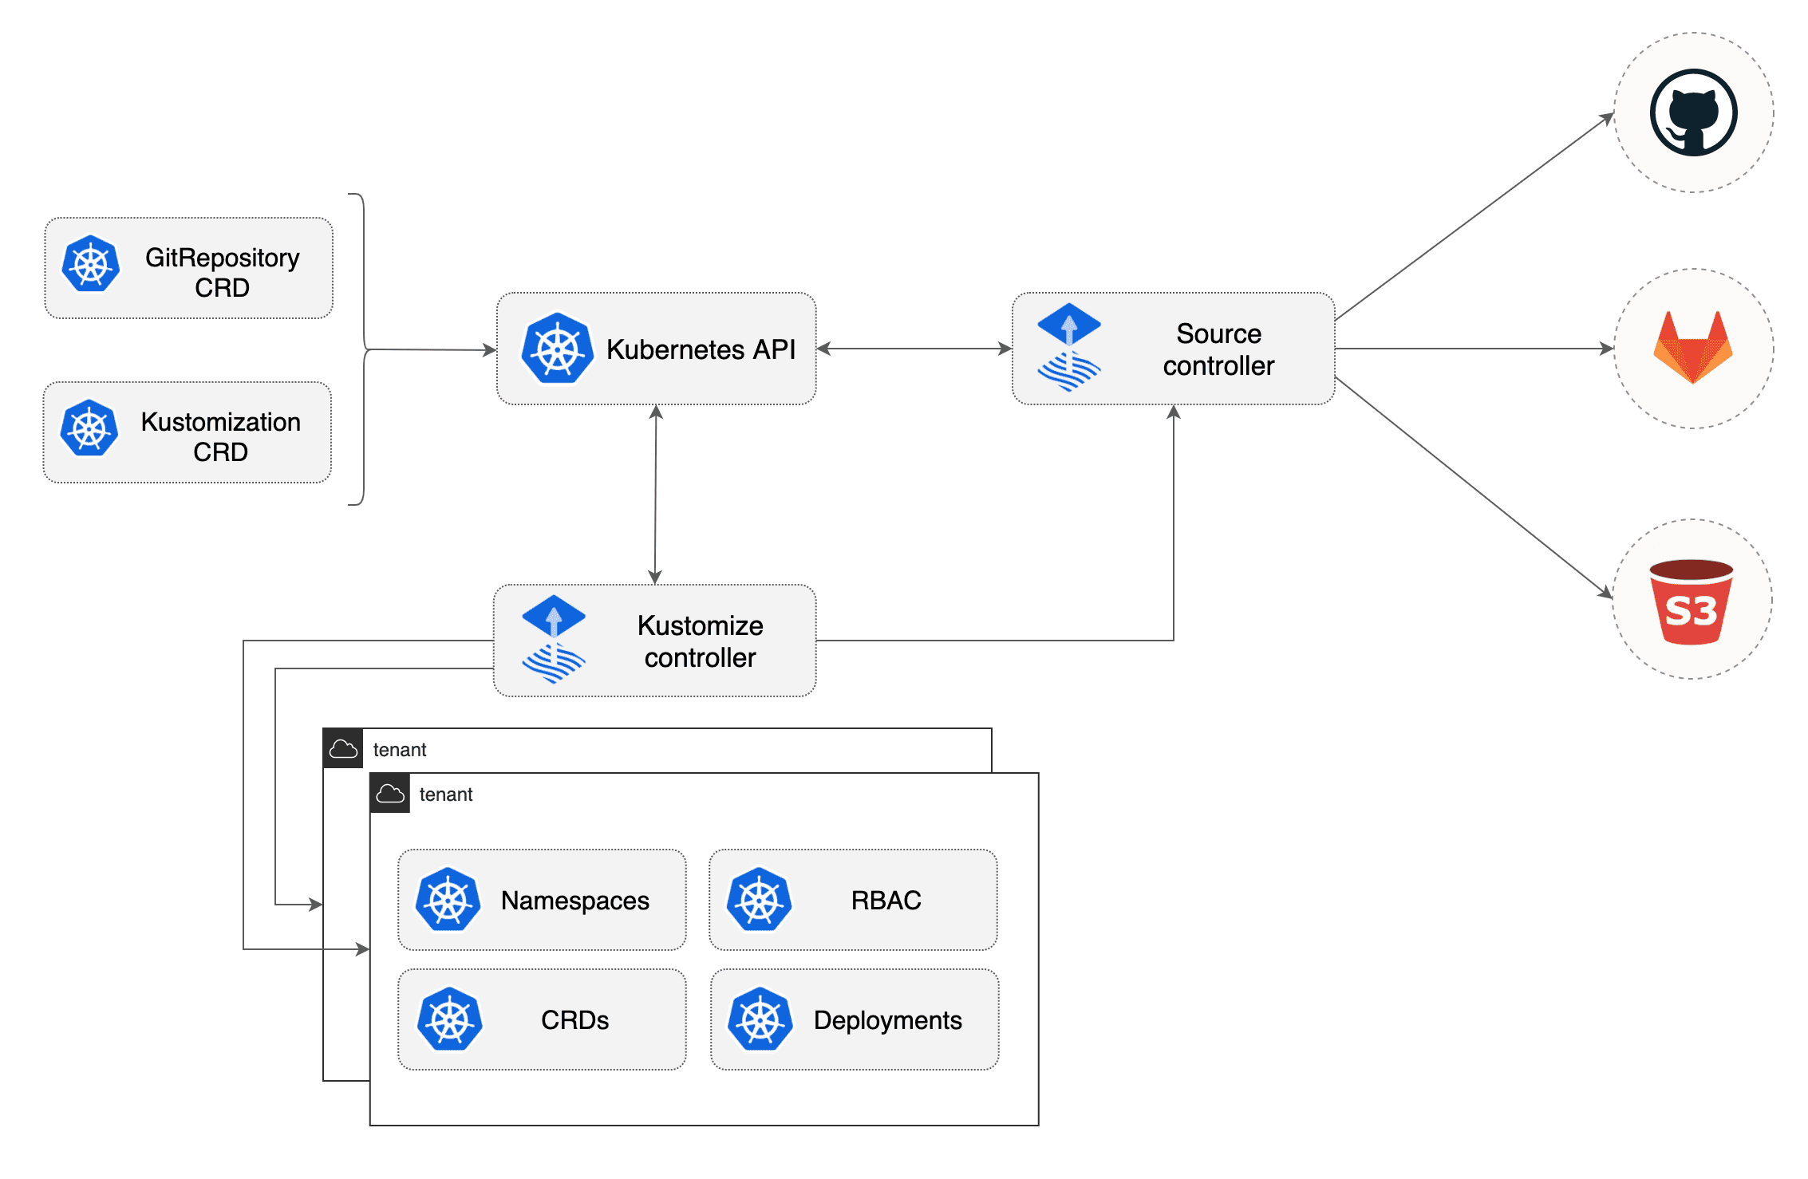
Kustomize Controller
Notes:
The kustomize-controller specialized in running continuous delivery pipelines for infrastructure and workloads defined with Kubernetes manifests and assembled with Kustomize.
Reconciles the cluster state from multiple sources (provided by source-controller)
Generates manifests with Kustomize (from plain Kubernetes yamls or Kustomize overlays)
Validates manifests against Kubernetes API
Impersonates service accounts (multi-tenancy RBAC)
Health assessment of the deployed workloads
Runs pipelines in a specific order (depends-on relationship)
Prunes objects removed from source (garbage collection)
Reports cluster state changes (alerting provided by notification-controller)

Slide 14
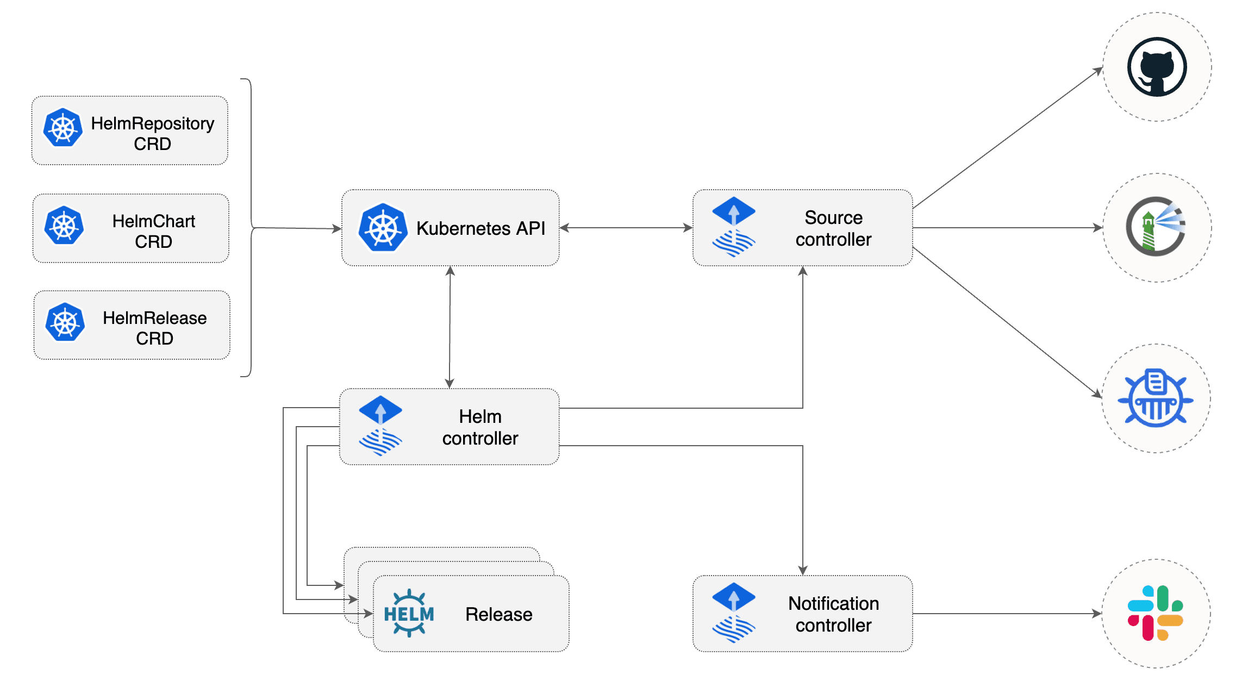
Helm Controller
Notes:
The Helm Controller is a Kubernetes operator, allowing one to declaratively manage Helm chart releases with Kubernetes manifests.
Watches for HelmRelease objects and generates HelmChart objects
Supports HelmChart artifacts produced from HelmRepository and GitRepository sources
Fetches artifacts produced by source-controller from HelmChart objects
Watches HelmChart objects for revision changes (including semver ranges for charts from HelmRepository sources)
Performs automated Helm actions, including Helm tests, rollbacks and uninstalls
Offers extensive configuration options for automated remediation (rollback, uninstall, retry) on failed Helm install, upgrade or test actions
Runs Helm install/upgrade in a specific order, taking into account the depends-on relationship defined in a set of HelmRelease objects
Prunes Helm releases removed from cluster (garbage collection)
Reports Helm releases statuses (alerting provided by notification-controller)
Built-in Kustomize compatible Helm post renderer, providing support for strategic merge, JSON 6902 and images patches

Slide 15
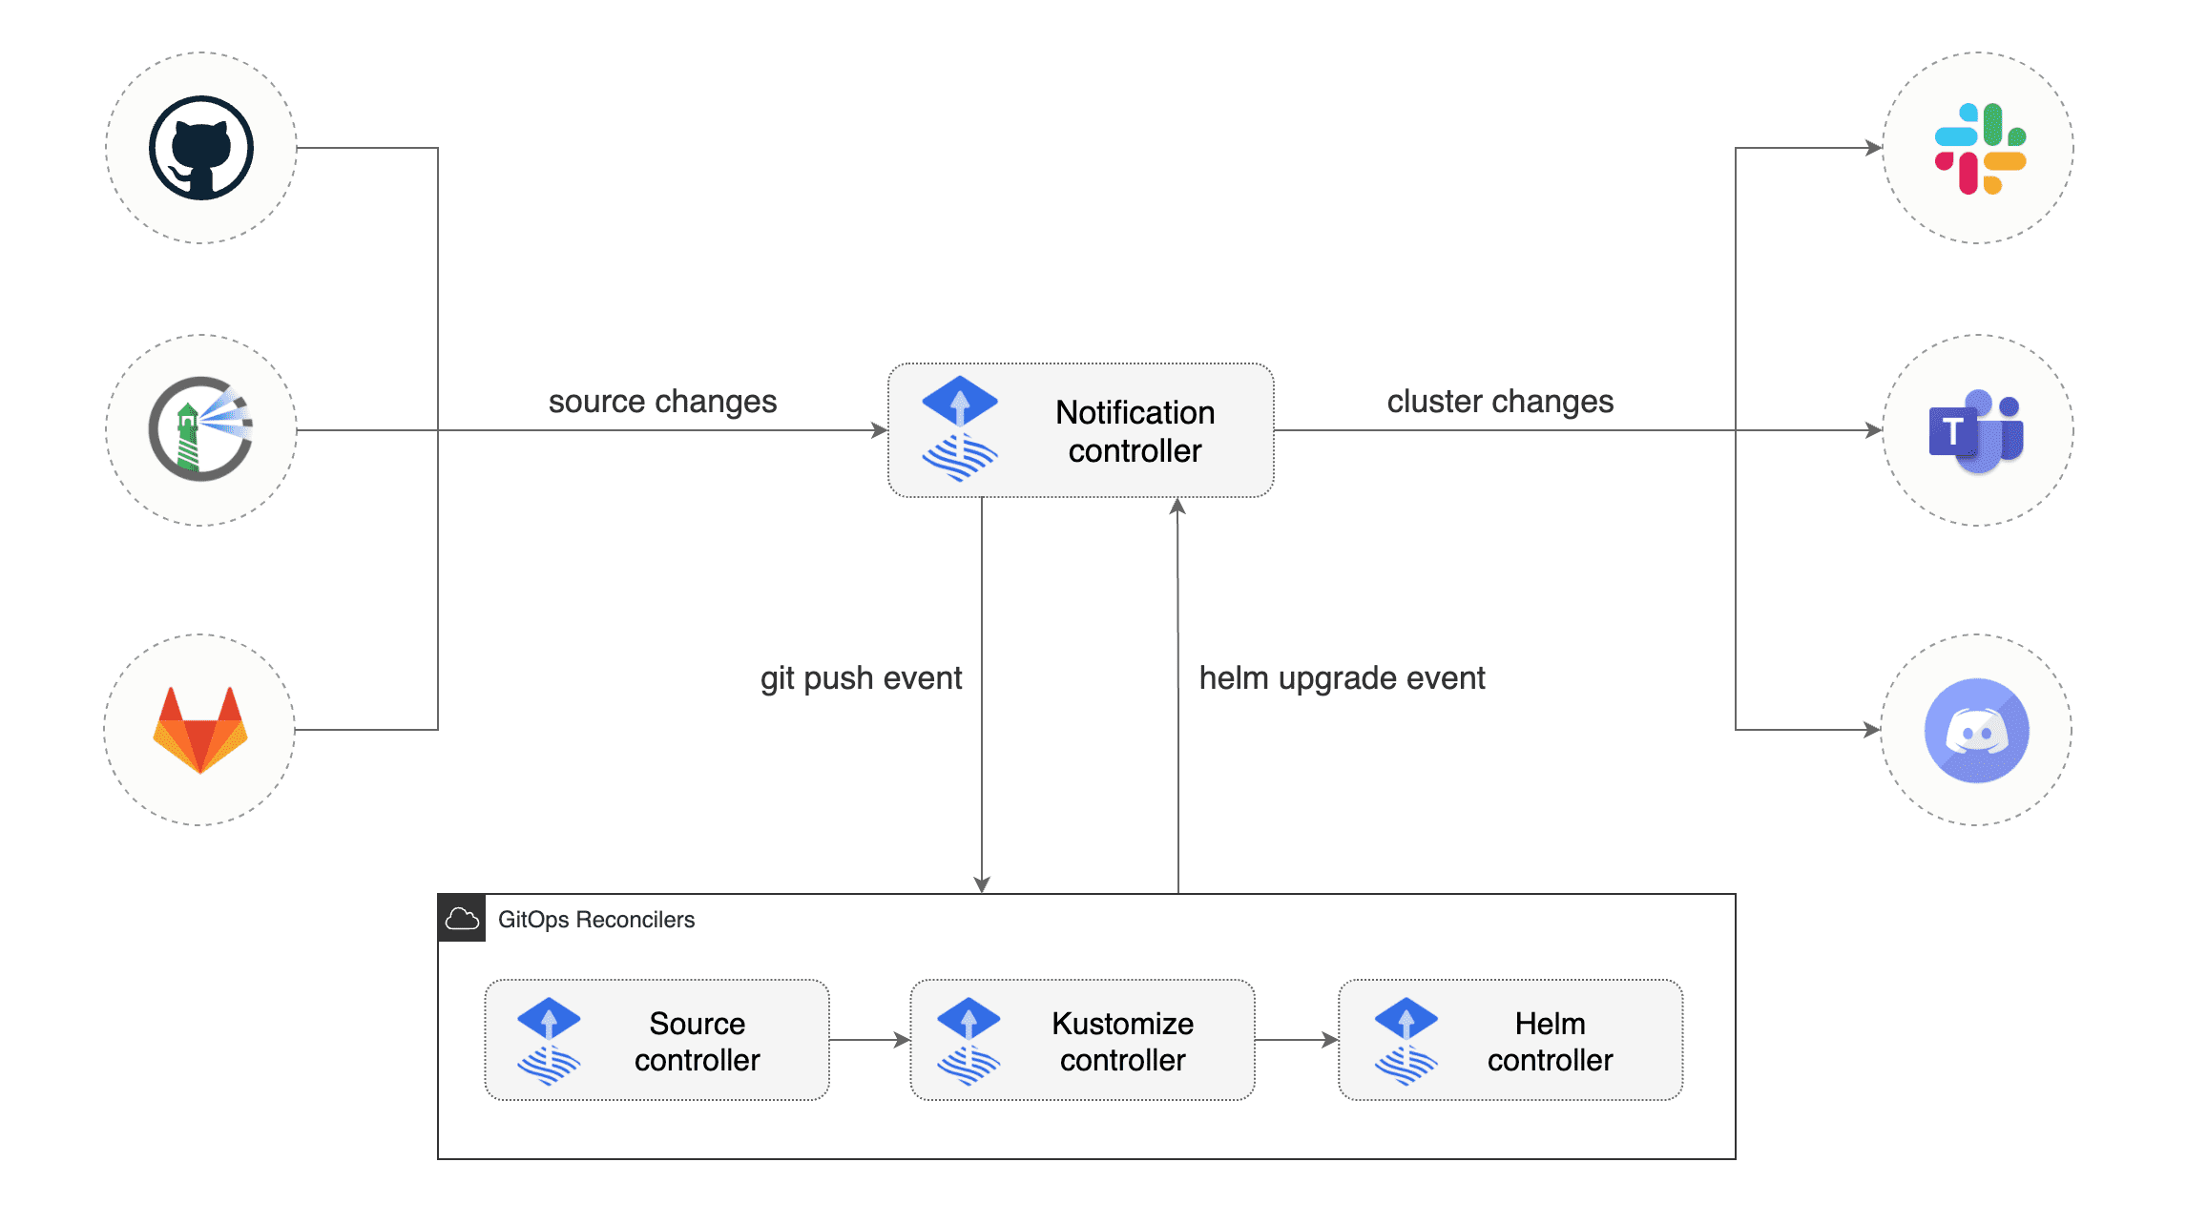
Notification Controller
Notes:
The Notification Controller is a Kubernetes operator, specialized in handling inbound and outbound events.
The controller handles events emitted by the GitOps toolkit controllers (source, kustomize, helm) and dispatches them to external systems (Slack, Microsoft Teams, Discord, Rocker) based on event severity and involved objects.

Slide 16







Workshop infra
iac-ws4-rg
iac-ws4-blue-aks
iac-ws4-green-aks
iac-ws4-red-aks

Slide 17
Labs 01-04

Slide 18


Slide 19
Labs 04-06

Slide 21
How to structure your repository?

Slide 22
Labs 07-09

